Slide 1



‘Shall I have a late-night snack or not?’ Using Ethos, Pathos, and Logos in Persuasive AI for Self-Control Dilemmas
AI and Trust
Yebom Choi, Hayeon Yang , Somi Joo, Yuqian Zheng, Nomundari Tengis
Notes:
Good afternoon everyone. Our research is titled “Shall I have a late-night snack or not?” Using Ethos, Pathos, and Logos in Persuasive AI for Self-Control Dilemmas. This work explores how AI can support people when they face everyday self-control decisions, such as late-night snacking, procrastination, or avoiding exercise. Our research team includes Yebom Choi, Hayeon Yang, Somi Joo, Yuqian Zheng, and Tengis Nomundari.

Slide 2



Agenda
1
2
3
4
5
Related Works
Expected Results
Expected Implications
Introduction
Method
Notes:
In this presentation, we will introduce the background of our study, review related work, explain our method, present the expected results, and discuss the implications for persuasive AI design.

Slide 3
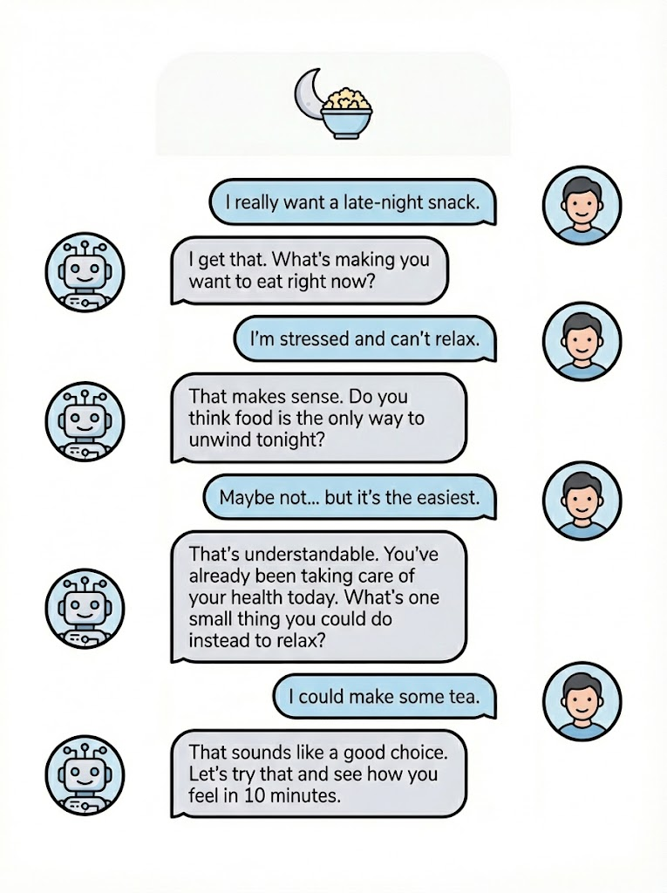
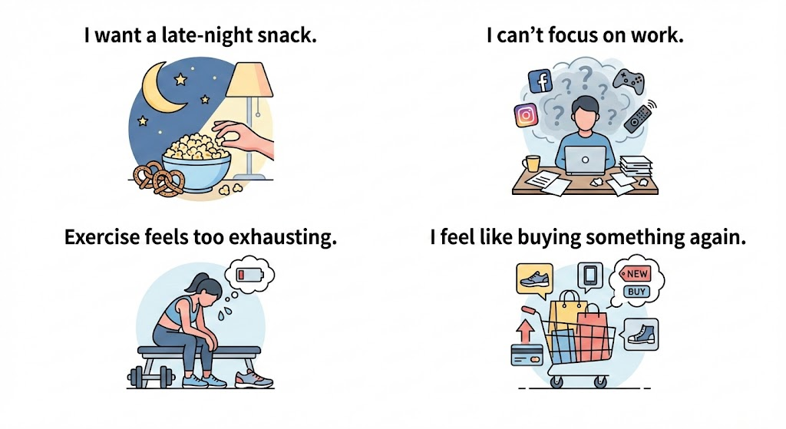

Introduction:
Everyday Self-Regulation in the Age of Conversational AI
Everyday Self-Regulation Decisions
Conversational Agents as Support
Notes:
Let's start with some everyday situations. As shown on this slide, many of us face self-regulation decisions every day. For example, “I want a late-night snack,” “I can't focus on work,” “Exercise feels too exhausting,” or “I feel like buying something again.”
Have you ever had experiences like these? In these moments, it is often difficult to overcome temptation by ourselves, especially when we are tired, stressed, or alone. This is where conversational AI can play an important role. As shown on the right side of the slide, an AI can talk with the user, ask questions, show understanding, and gently guide them to reflect on their choices.

Slide 4
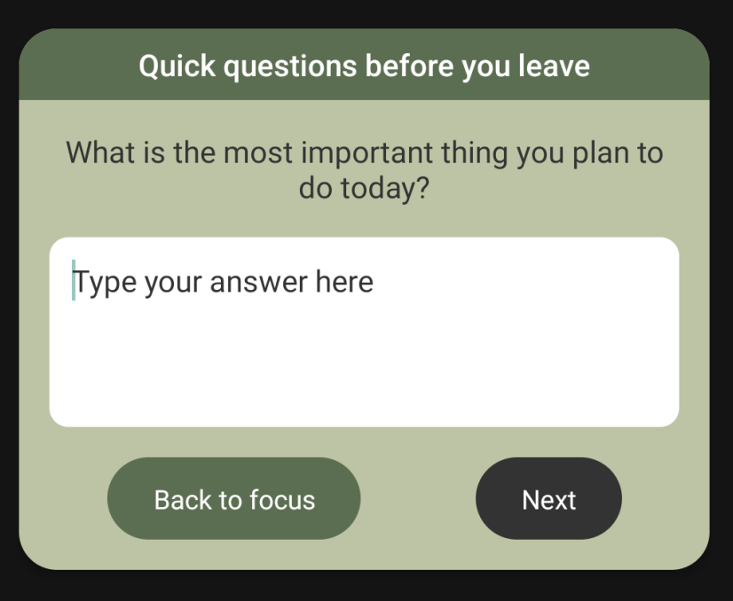
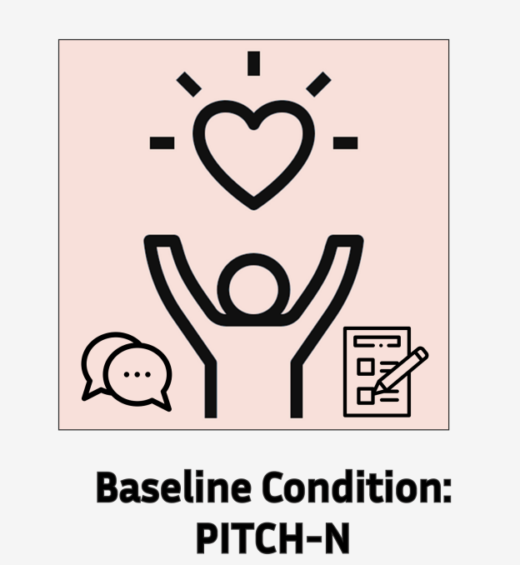

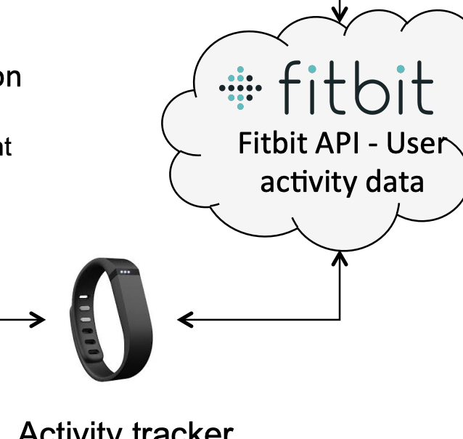
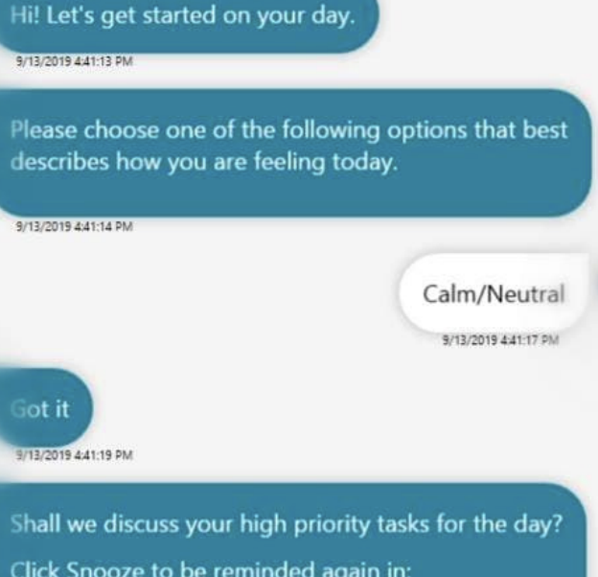

Introduction: Cases of Conversational Agents for Behavior Change
Li et al. (2024)
Reflective questions to raise awareness of smartphone use
Abbas et al. (2025)
Daily coaching with morning planning and evening reflection
Kocielnik et al. (2018)
Activity-data-driven conversations to promote exercise
Grover et al. (2020)
Emotion-expressive agents to manage focus and attention
Lack of theoretical grounding in persuasion strategies ❌
Unclear psychological mechanisms supporting intrinsic motivation ❌
Aristotelian Rhetoric
Self-Determination
Notes:
Recently, there has been growing research on conversational agents for behavior change, for example in smartphone use, daily coaching, exercise support, and focus management. These studies show that conversational agents can effectively support behavior change. However, existing research still has two main limitations.
First, there is a lack of theoretical grounding in persuasion strategies. Second, the psychological mechanisms that support intrinsic motivation are not clearly explained. To address these gaps, our study introduces two theoretical foundations: Aristotelian Rhetoric and Self-Determination Theory. By combining these frameworks, we aim to better understand how different persuasive styles of AI influence users' motivation and self-regulation.

Slide 5

Related Works: Aristotelian Rhetoric as a Theoretical Lens
Aristotelian Rhetoric defines persuasion through three core appeals: Ethos, Pathos, and Logos, which explain how speakers influence beliefs and decisions.
Ethos — Source Credibility
Persuasion based on the speaker’s character, morality, and expertise. In AI systems, Ethos is operationalized as Source Credibility, realized through an Expert Persona that conveys authority and reliability.
Pathos — Perceived Benevolence
Rooted in friendship and goodwill, emphasizing genuine concern for others. In AI interaction, Pathos corresponds to Perceived Benevolence, where users believe the agent acts in their best interest.
Logos — Rational Argumentation
Persuasion through logic and reason, expressed via rational argumentation and data-driven visualization, supporting users’ reasoning in a way similar to cognitive restructuring in CBT, which helps correct irrational beliefs.

Slide 6

Related Works: Self-Determination Theory
Motivation is strengthened when three basic psychological needs are satisfied: Autonomy, Competence, and Relatedness. Such motivation supports behavioral acceptance, persistence, and well-being.
Ethos → Autonomy
Credibility-based persuasion builds trust in the agent. Messages are perceived as supportive advice rather than external control, reducing threats to autonomy and increasing acceptance. (Pornpitakpan, 2004；Shen, 2010；Metzger & Flanagin, 2013)
Logos → Competence & Autonomy
Logical explanations help users understand the recommendation and feel capable of acting on it. Providing clear rationale also supports a sense of self-endorsed choice. (Deci & Ryan, 2000；Niemiec & Ryan, 2009)
Pathos → Relatedness
Empathy and emotional connection satisfy the need for relatedness. Feeling understood and cared for reduces resistance to persuasive messages. (Liu & Sundar, 2018；Shen, 2010；Ryan et al., 2008)

Slide 7
Method:
Theory-Based Persuasion Model
The Theoretical Framework: Bridging Rhetorical Persuasion and Psychological Needs in Al Agents

Slide 8
Method:
Hypotheses
Persuasive Style and Psychological Responses
Persuasive Style and Intrinsic Motivation
H1. Users’ perceived psychological reactance will differ significantly depending on the chatbot’s persuasive style (ethos, pathos, or logos).
H3. The chatbot’s persuasive style will have a significant effect on users’ intrinsic motivation, including perceived autonomy, competence, and relatedness.
H2. Users’ acceptance intention toward the chatbot’s message will differ significantly depending on the chatbot’s persuasive style.
Intrinsic Motivation, Reactance, and Acceptance
Mediating Role of Intrinsic Motivation
H4. Users’ intrinsic motivation will be negatively associated with psychological reactance.
H6. The relationship between the chatbot’s persuasive style and psychological reactance will be mediated by users’ intrinsic motivation.
H5. Users’ intrinsic motivation will be positively associated with acceptance intention toward the chatbot’s persuasive message.
H7. The relationship between the chatbot’s persuasive style and acceptance intention will be mediated by users’ intrinsic motivation.

Slide 9
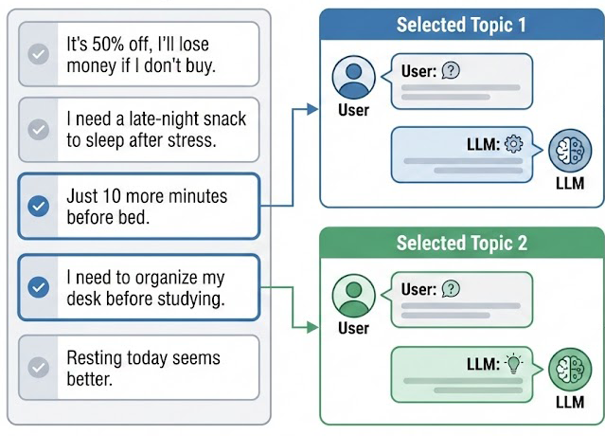


Method:
Experimental Design and Procedure
post-hoc measures
Intrinsic Motivation
Autonomy
I felt that following the AI’s advice was my own decision.
... ...
Competence
I felt confident that I could apply the AI’s advice effectively in my daily life.
... ...
Relatedness
I felt comfortable interacting with the AI.
... ...
Psychological Reactance
I felt that the AI’s advice was an intrusion.
... ...
66 adults with low self-regulation → 3 groups (Ethos / Pathos / Logos)

Slide 10
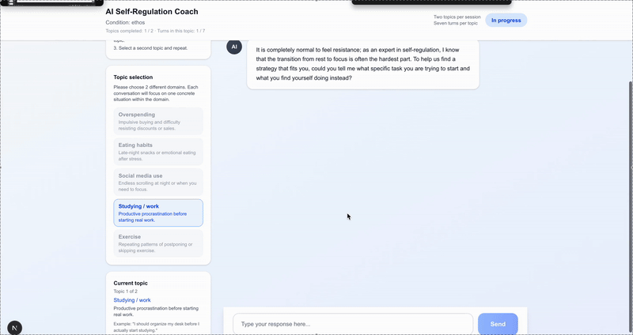
Method:
UI/UX Design and Survey Design

Slide 11
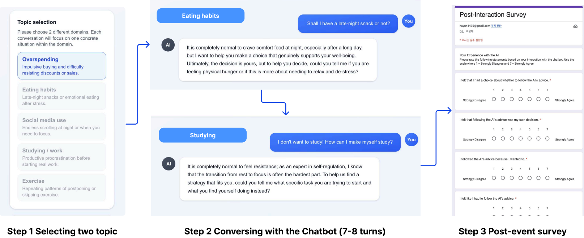
Method:
UI/UX Design and Survey Design

Slide 12



Expected Results:
Manipulation Check Analysis
Data were analyzed using SPSS 29.0 and PROCESS Macro (α = .05). Although participants completed two scenarios, rhetorical style was fixed across subjects and data were pooled for analysis.
Ethos condition
Participants are expected to rate the agent significantly higher on Perceived Expertise than the other two conditions, confirming the agent’s authoritative and credible persona.
Pathos condition
Participants are expected to report significantly higher Perceived Benevolence/Care, reflecting the successful communication of empathy and relational concern.
Logos condition
Participants are expected to rate the agent significantly higher on Perceived Rationality, validating the logic-driven and reason-based nature of the prompts.

Slide 13


Expected Results:
Main Effects on Dependent Variables
Results are based on a one-way MANOVA with Tukey’s HSD post-hoc comparisons, examining the main effects of rhetorical styles on Psychological Reactance, Behavioral Intention, Self-Efficacy, and Trust.
Psychological Reactance
Psychological reactance is expected to be lowest in the Pathos condition, because emotional care and empathy reduce perceived threats to user autonomy.
Acceptance Intention
Logos and Ethos are expected to elicit higher behavioral intention than Pathos, since logical justification and authoritative guidance more effectively motivate action in task-oriented contexts.

Slide 14
Expected Results:
Mediation Analysis - The Role of SDT Needs
Parallel multiple mediation analysis using PROCESS Macro (Model 4; Hayes, 2013)
Pathos → Relatedness →
Reduced Psychological Reactance
Pathos strengthens users’ sense of relatedness by expressing care and empathy. Feeling understood reduces perceived threats to autonomy, thereby lowering psychological reactance.
Logos → Autonomy →
Increased Acceptance Intention
Logos provides clear and objective rationale that supports informed decision-making. When users feel the choice is self-endorsed through reasoning, their intention to act increases.

Slide 15
Expected Implications:
Theoretical Implications & Practical Implications
Theoretical
Practical
From Static to Conversational Nudges
Adaptive Persuasion Systems
AI rhetoric is not just language style, but a real-time intervention that shapes decision-making.
Scenario-based switching: Agents should adjust rhetorical styles to user context (e.g., Logos for rationalized impulse buying, Pathos for emotional eating).
Rhetorical Styles Activate Different Motivations
Users distinguish Ethos, Pathos, and Logos as different agent personas.
Real-time adaptation: Systems should dynamically respond to users’ SDT states, using Ethos to boost competence and Logos to support autonomy.
Each style triggers a distinct motivational pathway.
The SDT User–Strategy Fit
Retention via Therapeutic Alliance
Persuasion works best when rhetorical strategy matches unmet SDT needs
Users are more likely to stay engaged when AI interventions are perceived as care-driven rather than algorithmic control.

Slide 16
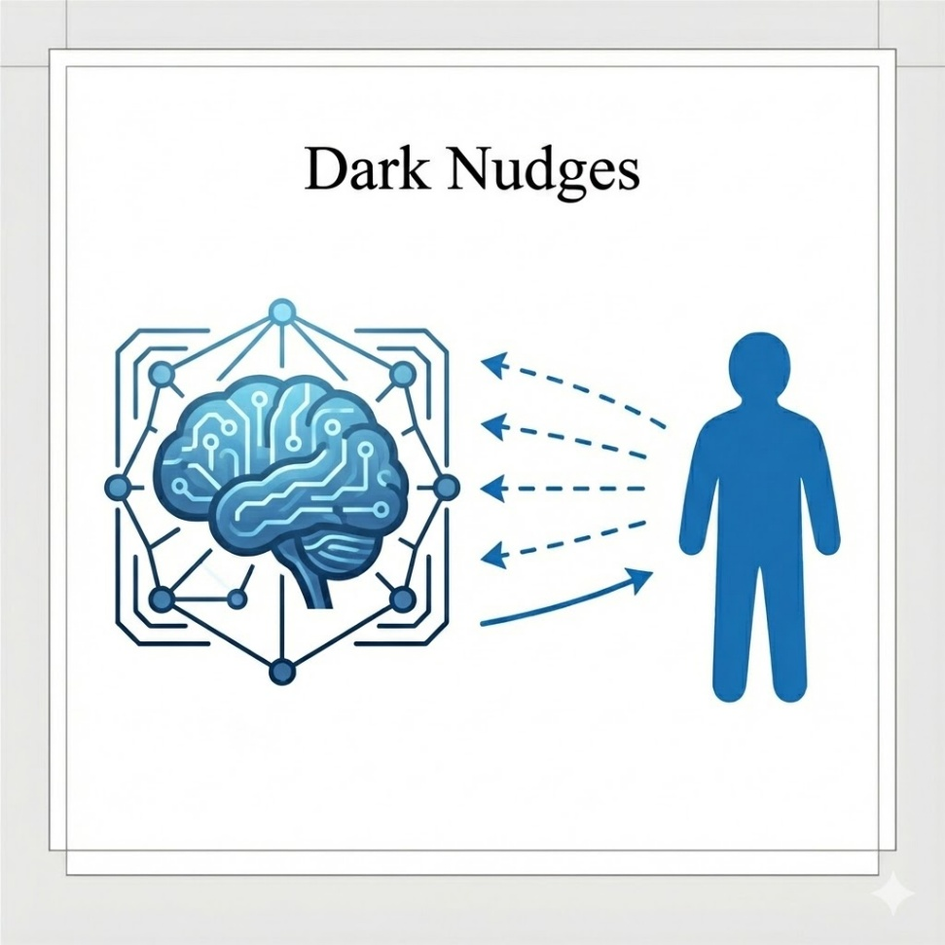
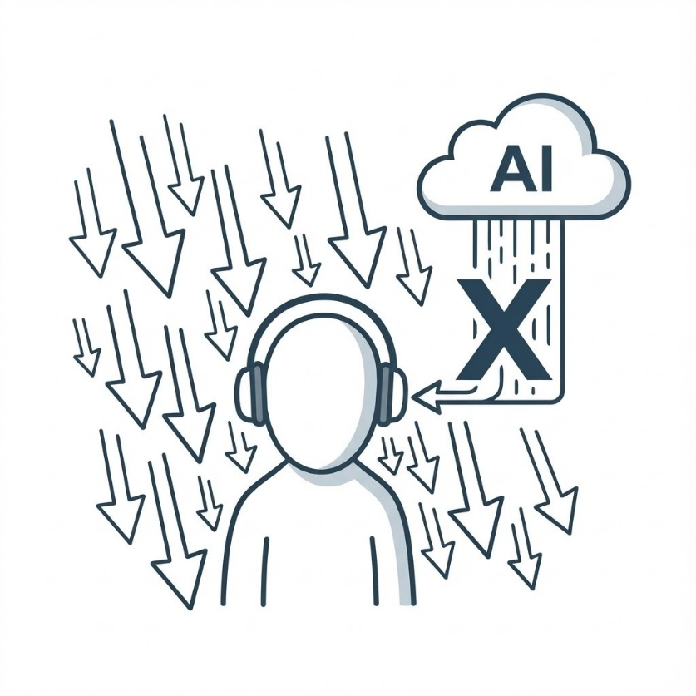
Expected Implications:
Ethical Implications
The Risk of “Dark Nudges”
Persuasive AI mechanisms can be misused for commercial manipulation, such as exploiting Ethos or Pathos to drive impulse buying or addictive behaviors.
Ethical guidelines should require transparency when AI employs persuasive rhetoric, especially in financial and health contexts.
Avoiding Algorithmic Paternalism
Overly directive AI interventions risk becoming algorithmic paternalism, undermining users’ self-regulation and fostering dependency.
Ethical AI should prioritize Logos and autonomy, empowering users to make informed decisions rather than dictating behavior.

Slide 17
Thank you

